Slide 1


SWP391: FINAL PROJECT PRESENTATION
TechnoStore System
Mentor:
Vương Minh Tuấn

Slide 2







Team member
Nghiêm Xuân Lộc - HE170939
Bùi Phi Thông - HE171683
Nguyễn Bá Hà - HE171364
Nguyễn Kim Quang - HE170861

Slide 3



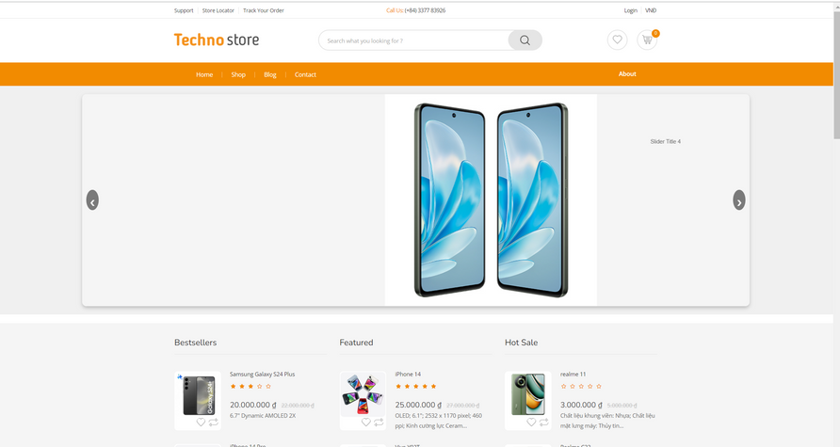





PRODUCT INTRODUCTION & SCOPE
INTRODUCTION:
The "TechnoStore" system was built to meet people's increasing demand for online shopping for electronic devices.
Scope:
Guest/Customer: Users can shop online, review products, view blogs.... from the website.
Admin: Admin manager user and website, authorization user.
Marketing: Manages all aspects of marketing for an online system, and improve customer engagement.
Sales:The organization's sales members are responsible for product management and analyzing customer purchasing trends

Slide 4





















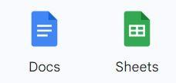





PROJECT COMMUNICATION
Technologies
Meeting
Task assignment:
Tool

Slide 5

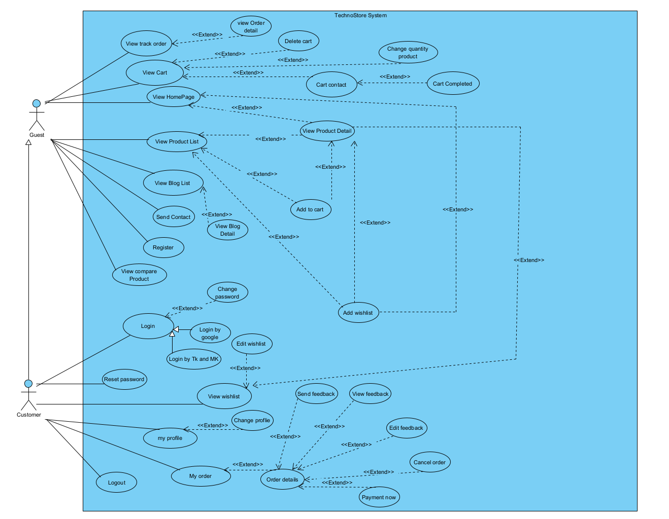

Product Requirements Use Case Diagrams
UC Diagram for Guest/ Customer

Slide 6
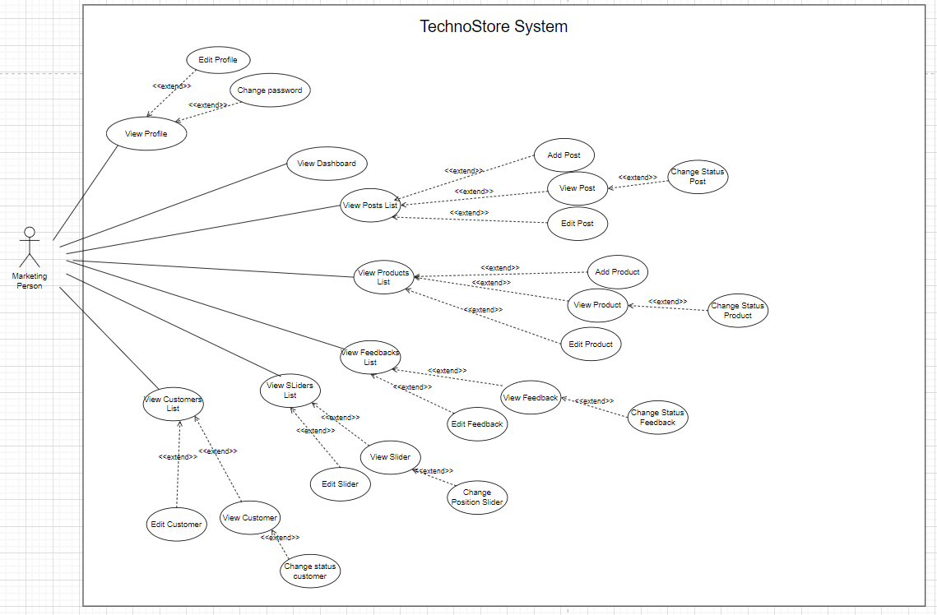
Product Requirements Use Case Diagrams
UC Diagram for Marketing

Slide 7
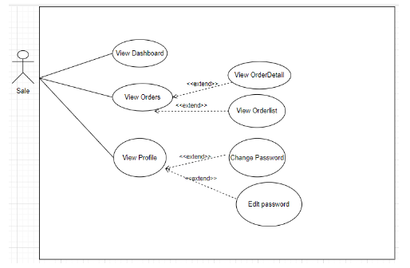
Product Requirements Use Case Diagrams
UC Diagram for Sale

Slide 8
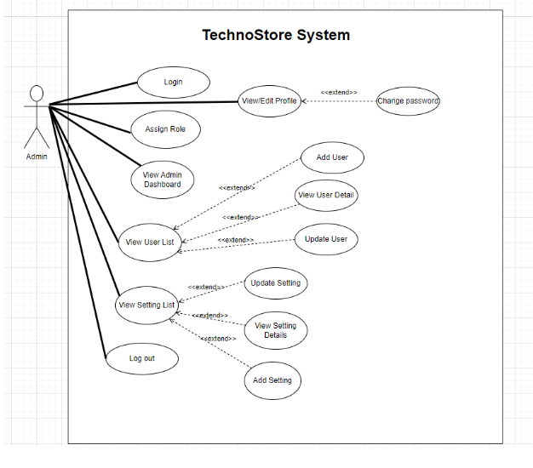

Product Requirements Use Case Diagrams
Requirements Use Case Diagrams
UC Diagram for Admin

Slide 9

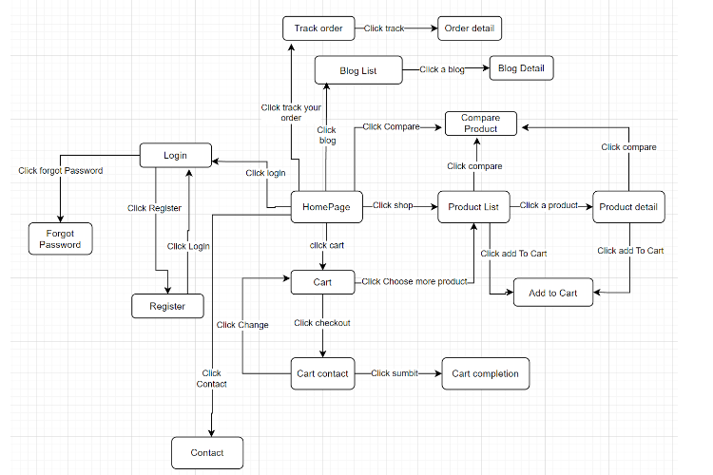
Product Requirements Functionalities-Screen ﬂow
Guest Site Screens Flow

Slide 10

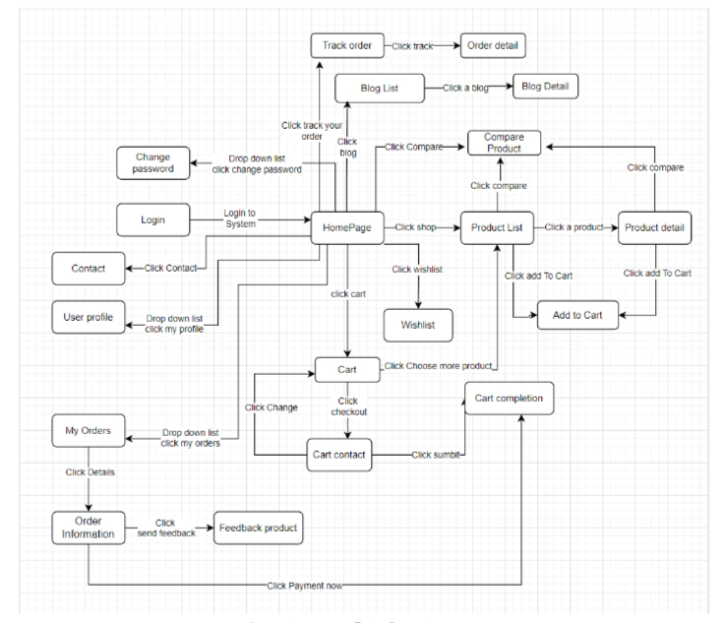
Product Requirements Screen ﬂow
Customer Site Screens Flow

Slide 11
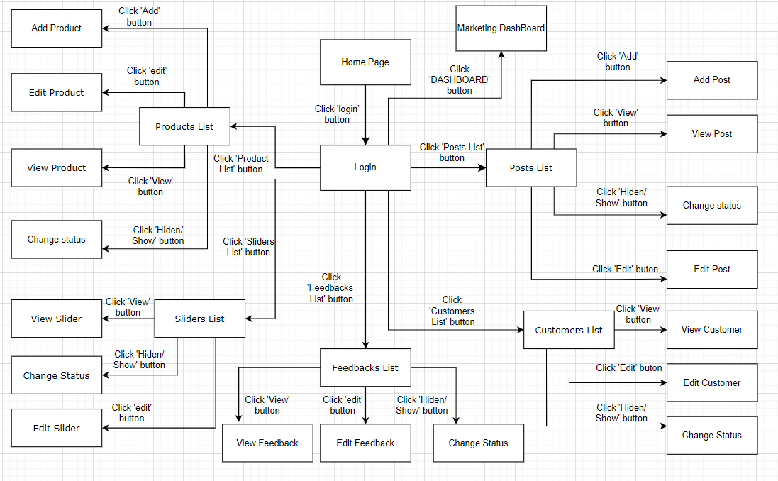
Product Requirements Screen ﬂow
Marketing Site Screens Flow

Slide 12
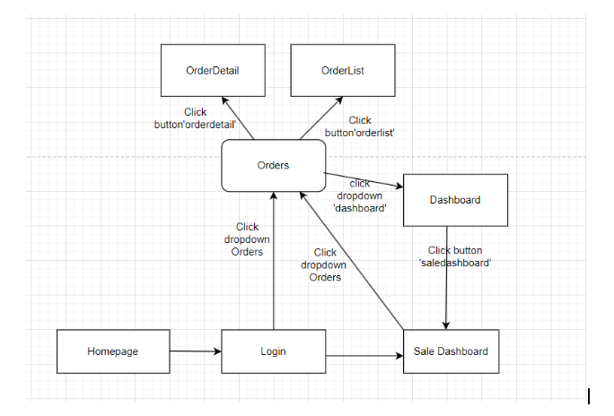
Product Requirements Screen ﬂow
Sale Site Screens Flow

Slide 13
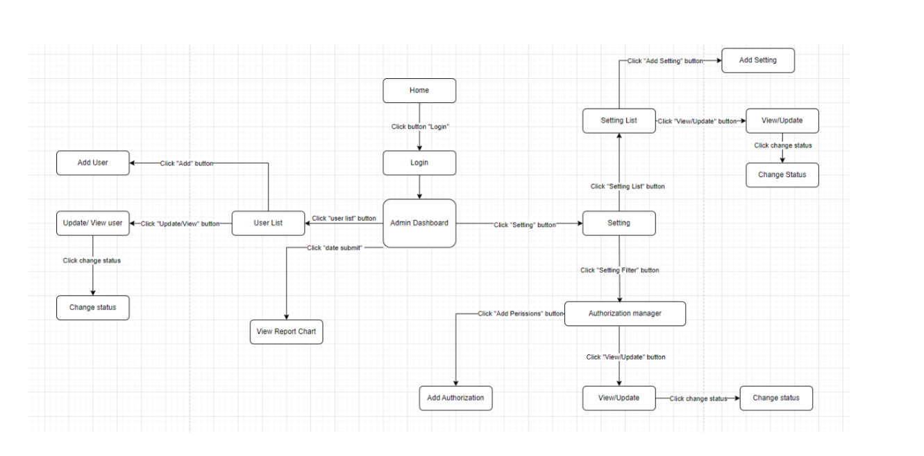
Product Requirements Functionalities-Screen ﬂow
Admin Site Screens Flow

Slide 14
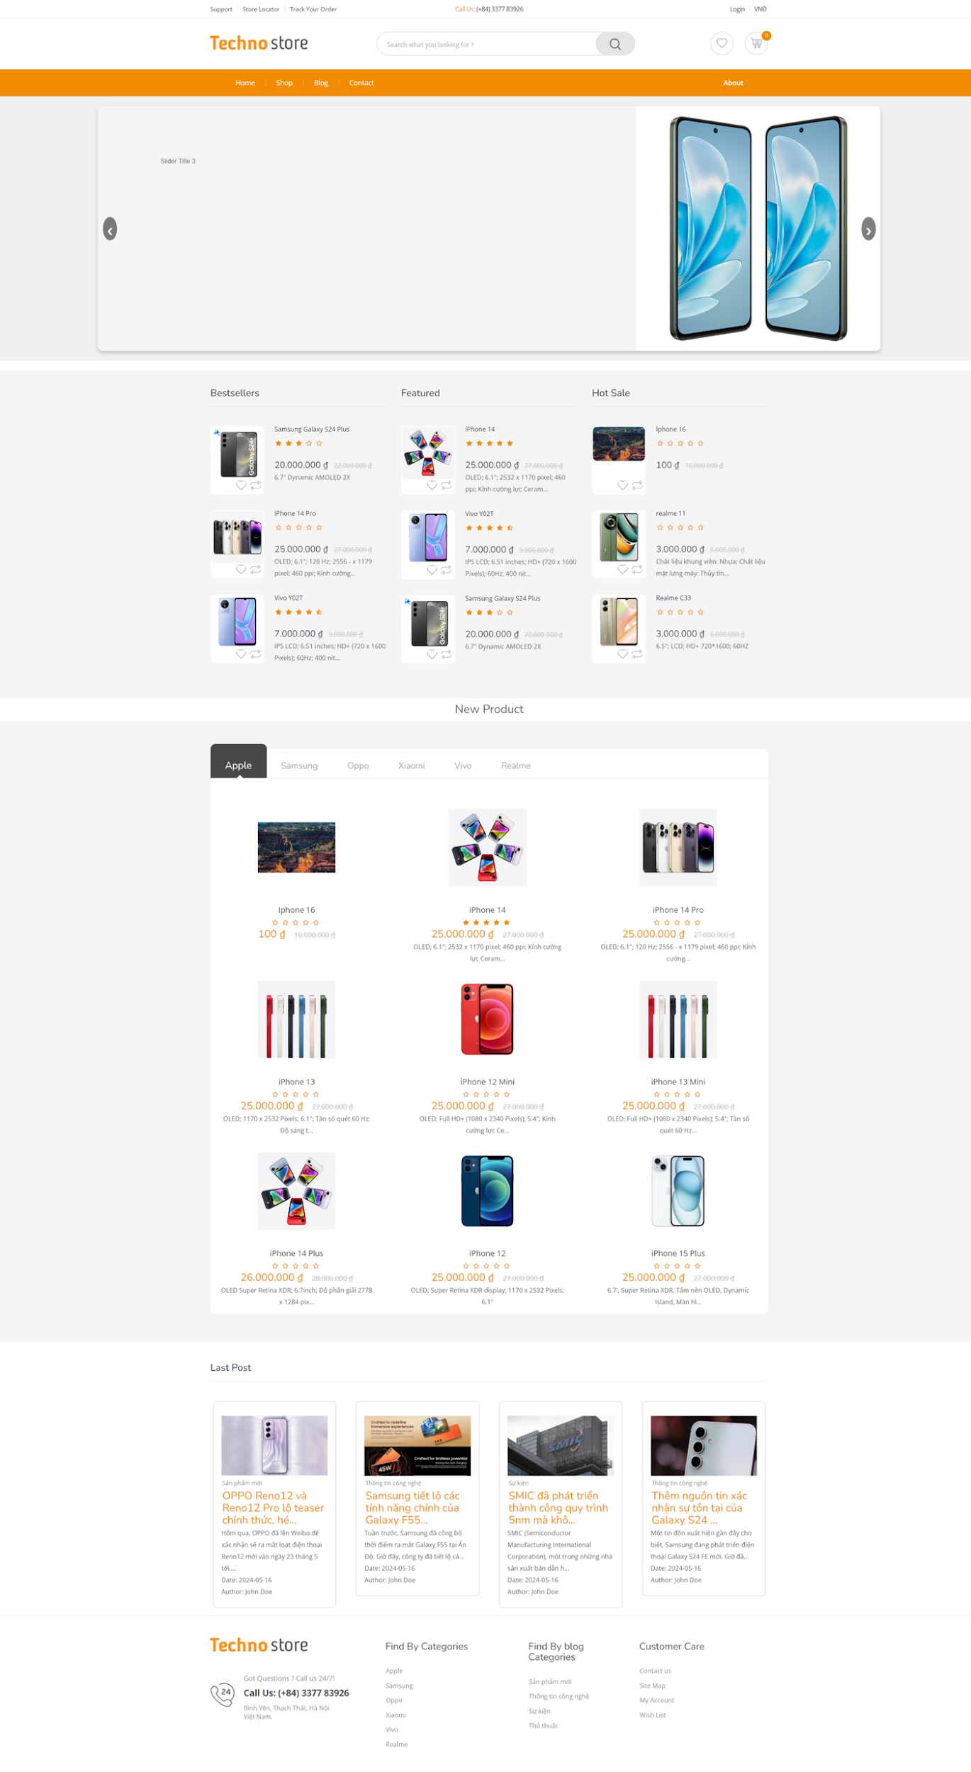
Product Requirements Main Screen UI Design(Guest/Customer)

Slide 15
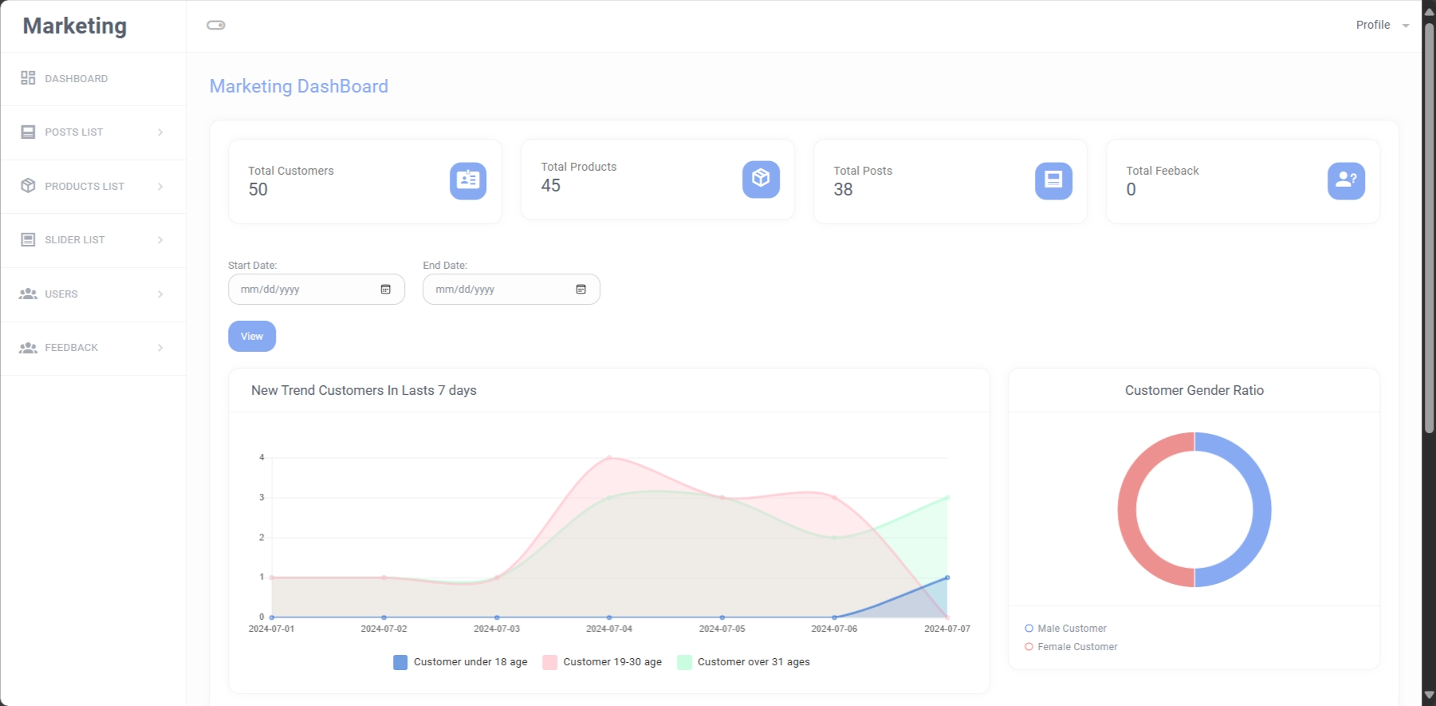
Product Requirements Main Screen UI Design (Marketing)

Slide 16
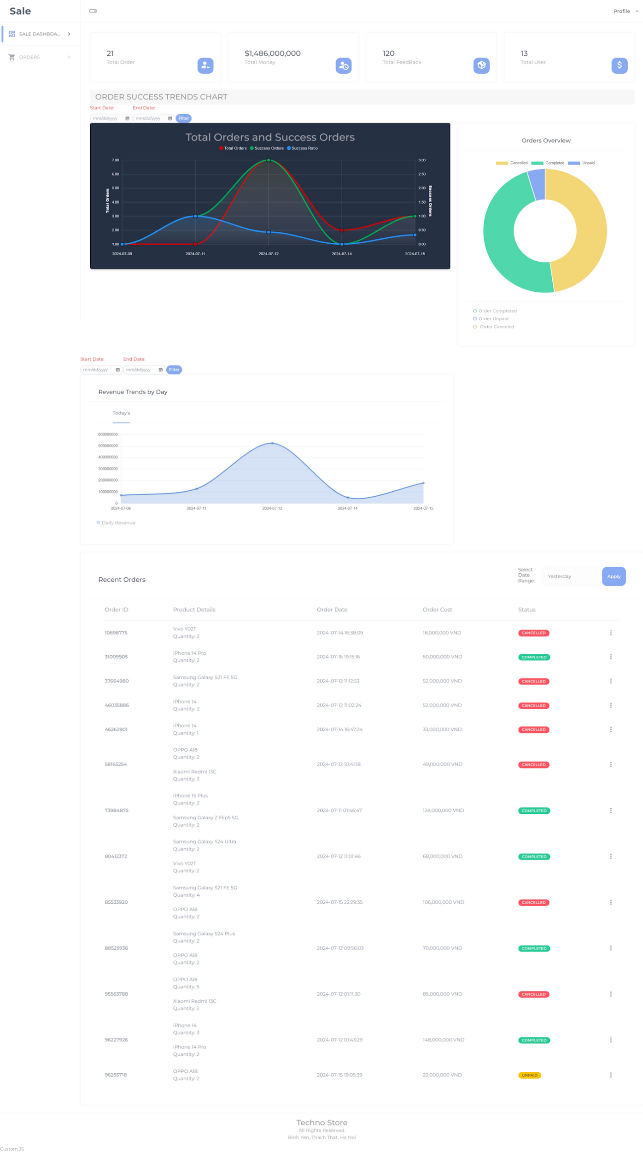
Product Requirements Main Screen UI Design(Sale)

Slide 17
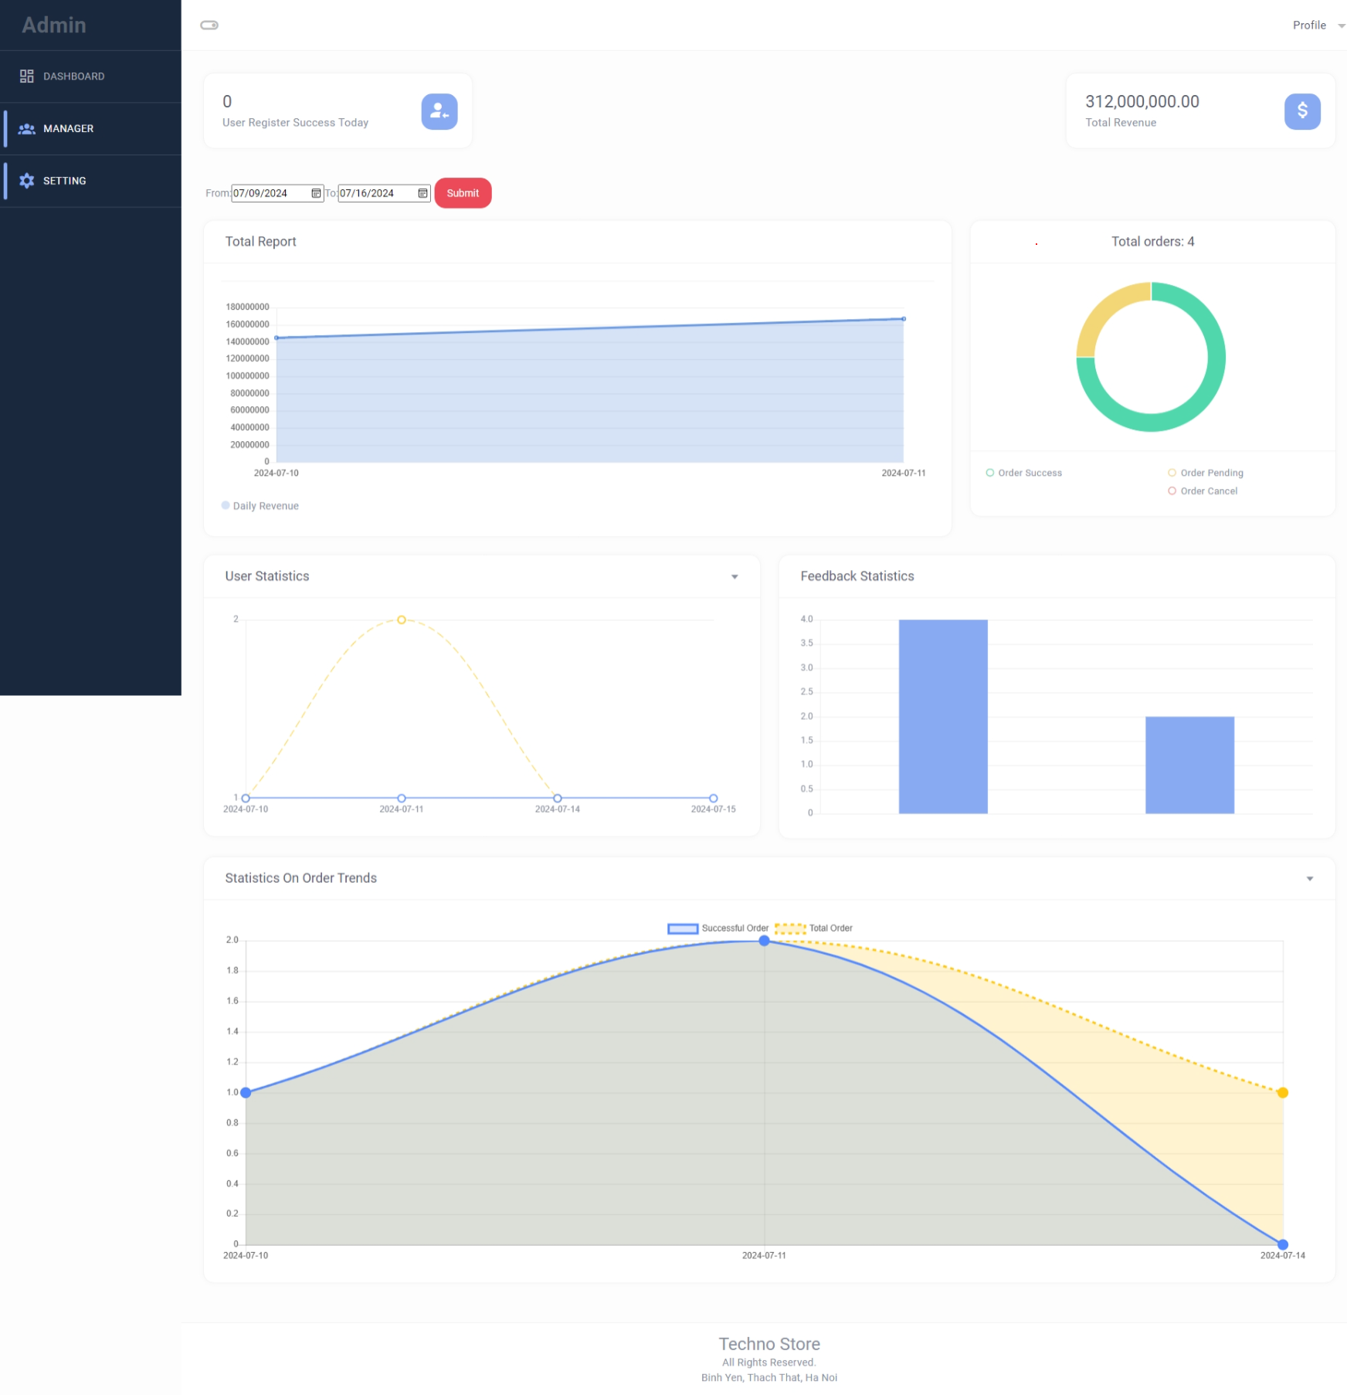
Product Requirements Main Screen UI Design (Admin)

Slide 18
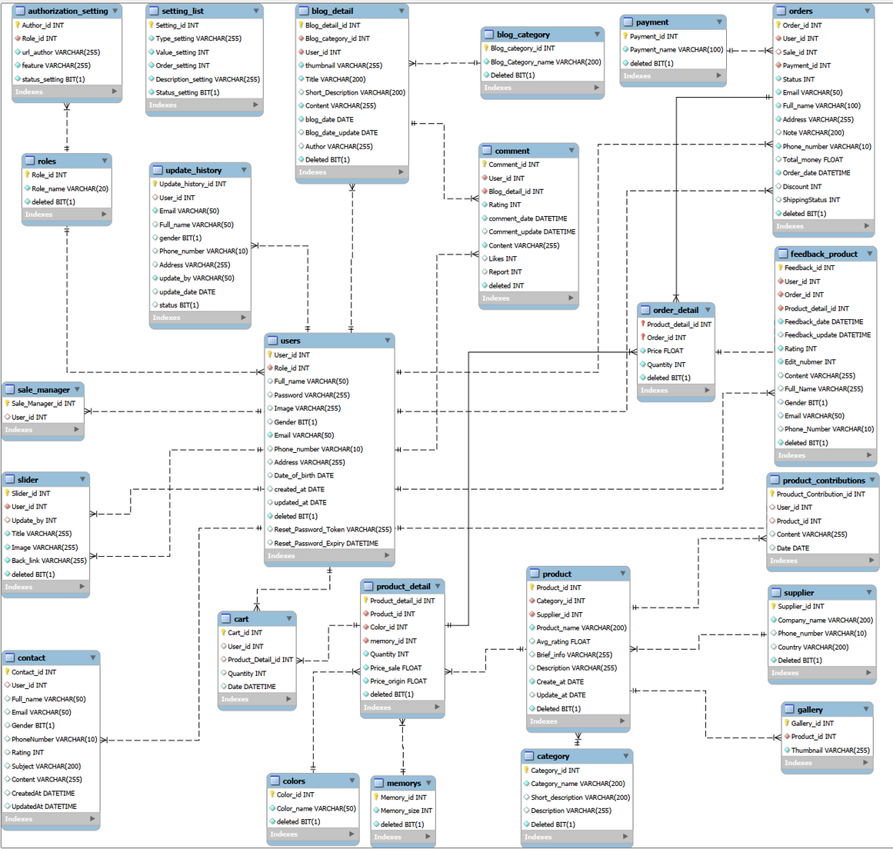
System Design
Database Design

Slide 19

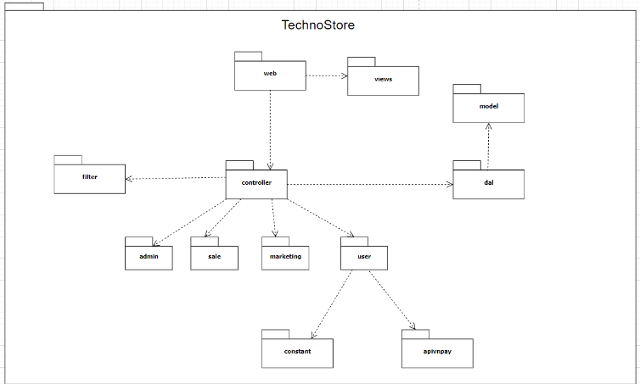
System Design
Package Diagram

Slide 20











Slide 21



